Slide 1

StockSmart: Food Inventory Tracker
CSE 111 Fall 2024: Project Checkpoint 1
By Cheska Cinderella Friend and Lucia Barboza

Slide 2

Synopsis
StockSmart is a kitchen inventory management system designed to assist users in tracking their pantry, fridge, and freezer items.
It helps users optimize food usage, reduce waste, and maintain healthier eating habits.
The system offers real-time inventory updates, nutritional tracking, and alerts for upcoming expiration dates.
By doing so, it ensures efficient grocery management and reduces food wastage, making kitchen management smoother and more organized.

Slide 3
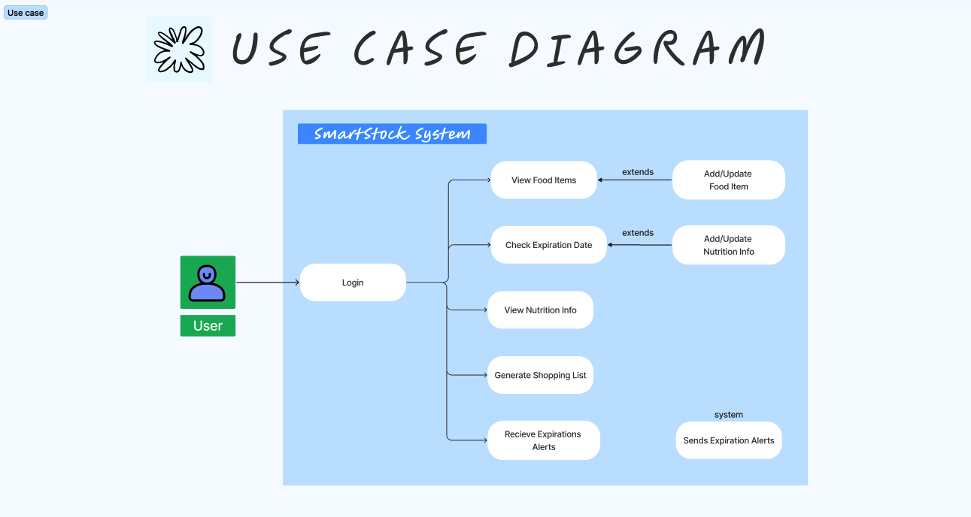

Slide 4
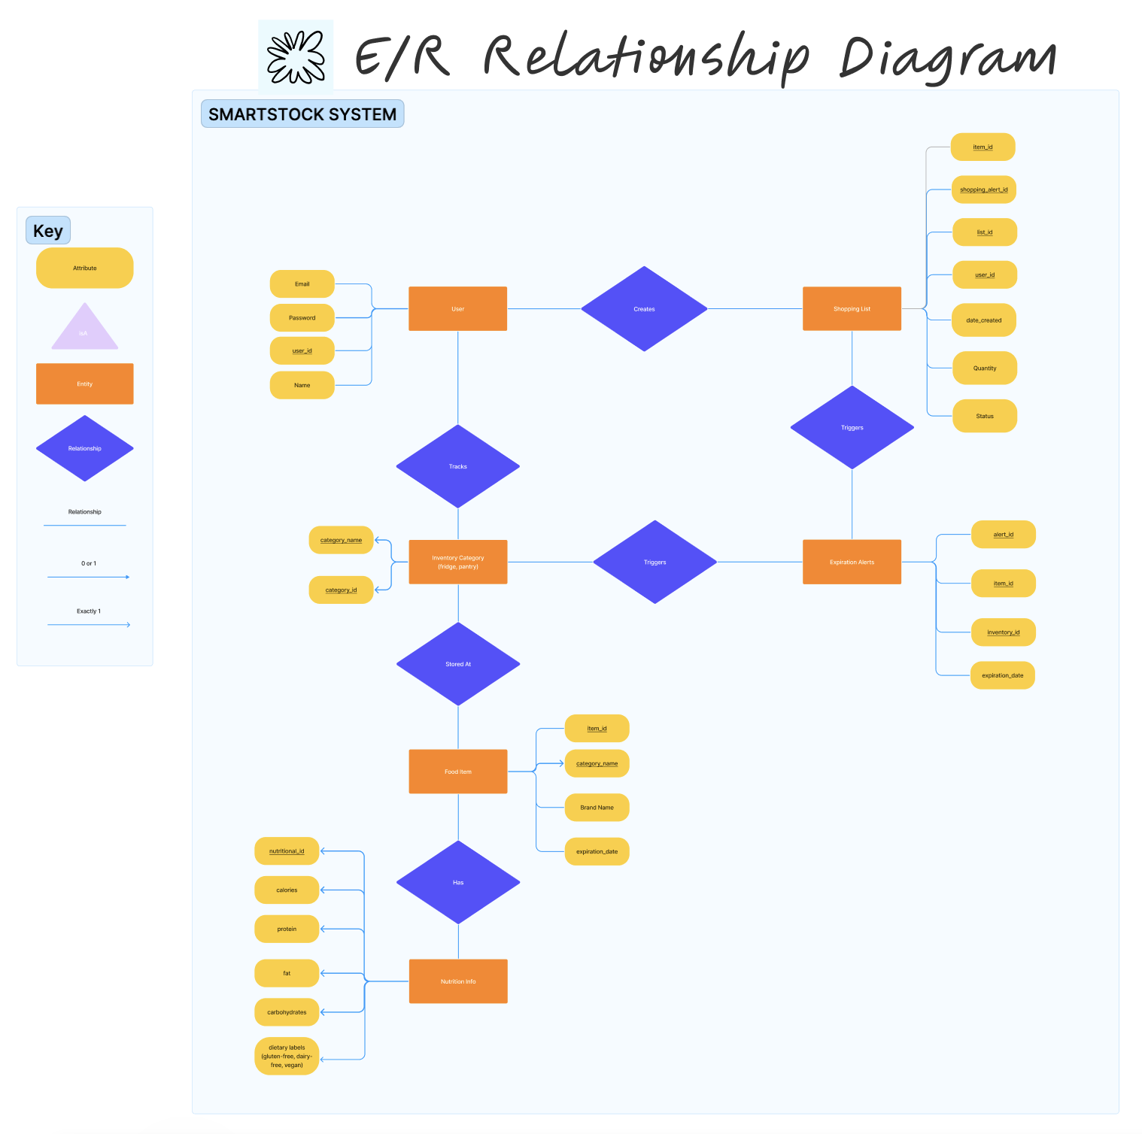

Slide 5
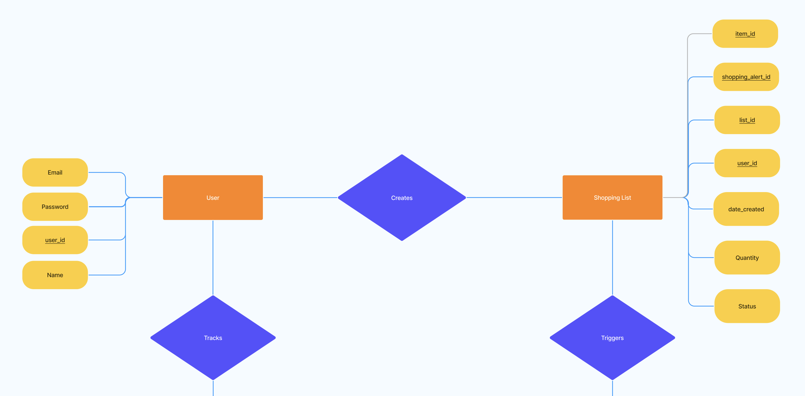

Slide 6
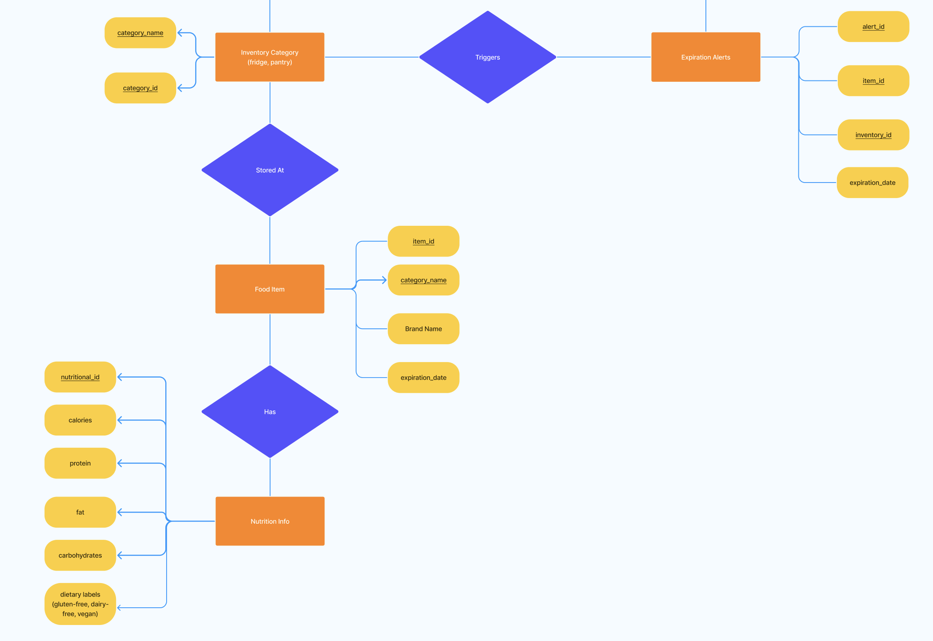

Slide 7
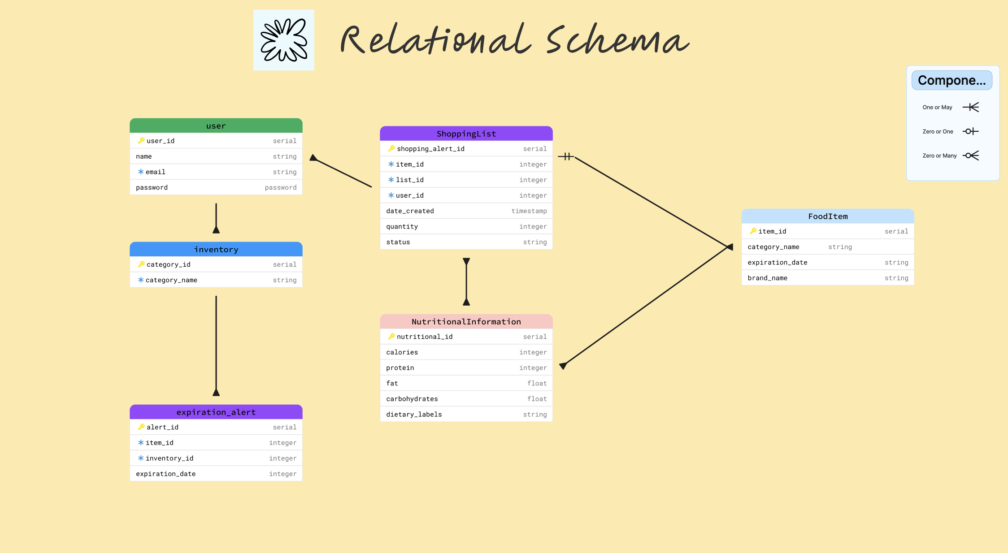

Slide 8



Environments/Languages
React.js
Node.js
SQLite 3

